Slide 1
Prospecting, Recruiting and Sponsoring

Slide 2
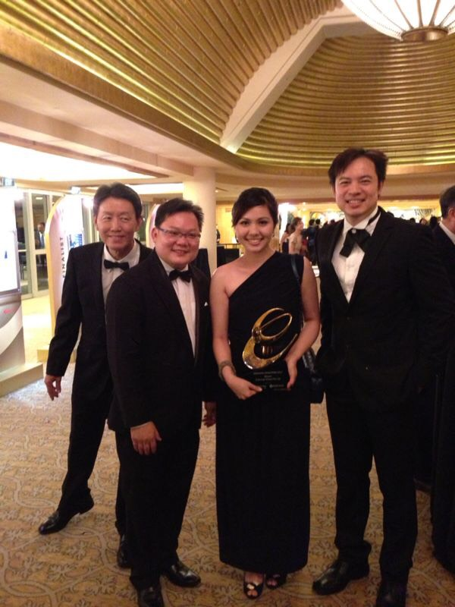
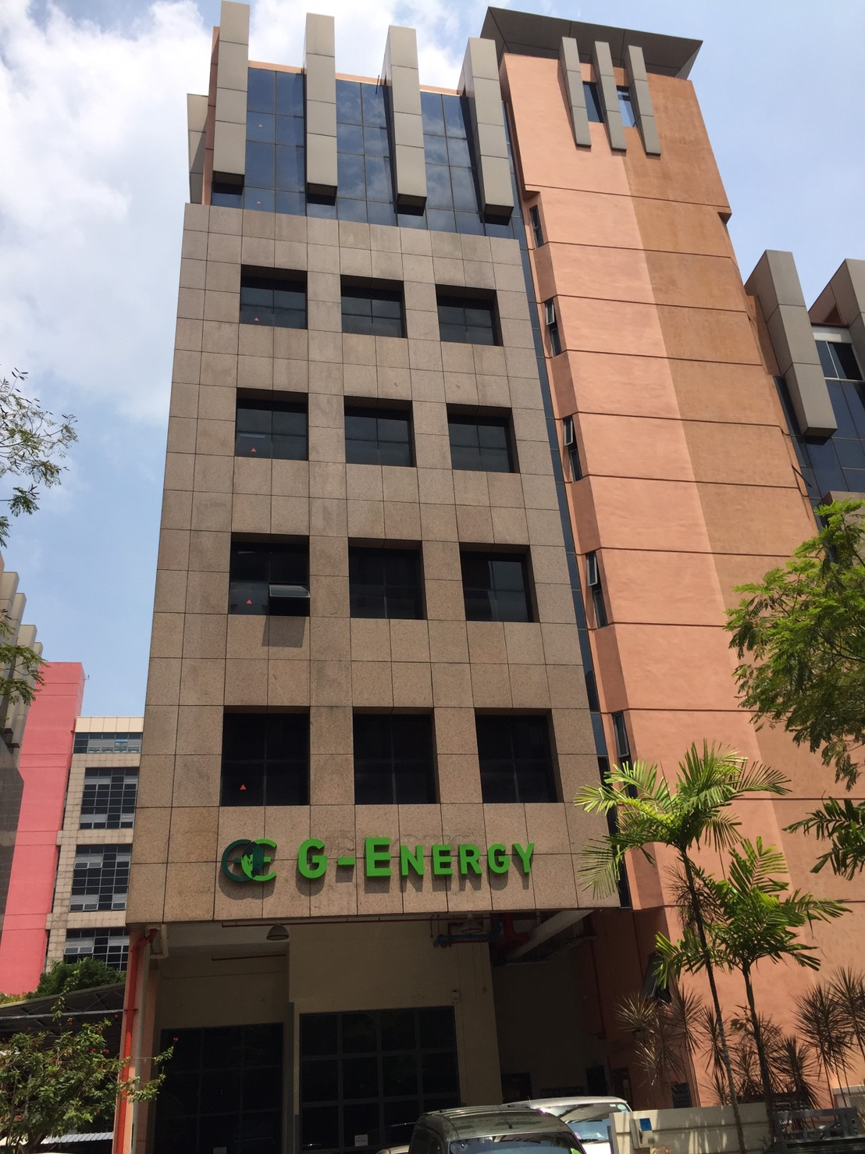
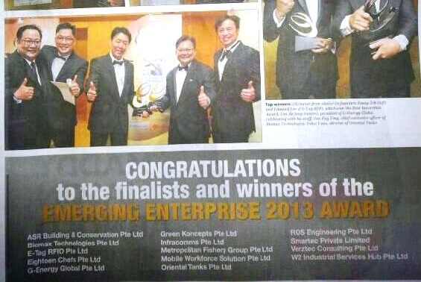
HELP TO SAVE ENERGY

Slide 3
Prospecting, Recruiting and Sponsoring
Duplicates Your Efforts and Leverages Your Time!

Slide 4
- J. Paul Getty - Founder of Getty Oil Company, Philanthropist, and, by the late 1950’s, widely regarded as the richest man in the world.
“I would rather have 1% of the efforts of a 100 people, than a 100% of my own efforts.”

Slide 5
What are their commonalities?
SYSTEM
Over 46,000 in the world
Over 34,000 in the world
Over 20,000 in the world

Slide 6
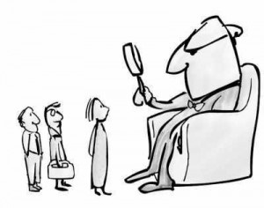
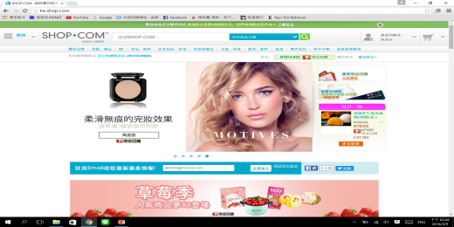
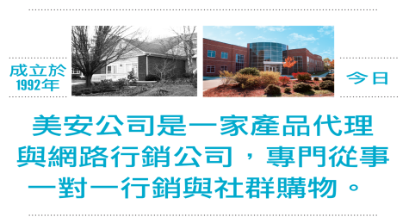
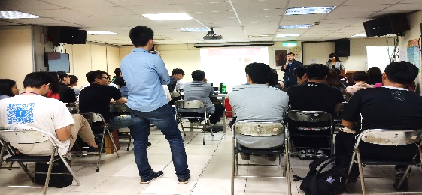
Proper Recruitment System
Business
Opportunity
MPCP
Methods
PROSPECTING
HBP
UBP
GMTSS
Team
Joining cooperation
Rights and obligations
CORING
Don’t challenge MA System

Slide 7
Prospecting, Recruiting and Sponsoring

Slide 9
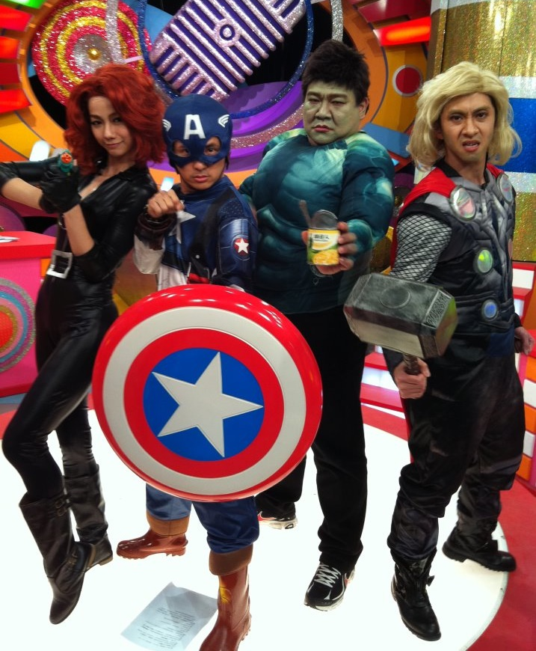
What kinds of team power do you want to build? Depends on your “Prospecting” & “Steps”

Slide 10
Prospecting, Recruiting and Sponsoring

Slide 11
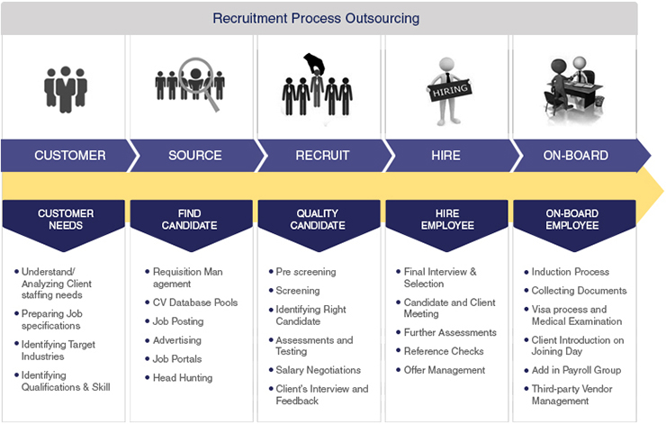
Understanding/
Analyzing Client
staffing needs
Preparing Job
specifications
Identifying Target
Industries
Identifying
Qualifications &
Skill
Requisition Man
augment
CV Database Pools
Job Posting
Advertising
Job Portals
Head Hunting
Pre screening
Screening
Identifying Right
Candidate
Assessments and
Testing
Salary Negotiations
Client’s Interview
and Feedback
Final Interview &
Selection
Candidate and
Client Meeting
Further Assessments
Reference Checks
Offer Management
Induction Process
Collecting Documents
Visa process and
Medical Examination
Client Introduction on
Joining Day
Add in Payroll Group
Third-party Vendor
Management

Slide 12
Warm Market
Friends, family, neighbors, teammates
High school classmates
College classmates
Organizations, associations, or groups that you belong to or have belonged to
Work colleagues (current and past positions)
Building A Names List
Social media

Slide 13
Sources of Possibilities
Work
Clubs
Church
School
Gymnasium
College Course
Charity
Social Networks
Networking Groups
Chamber of Commerce
Meetups
3 Foot Rule Daily Routine
Associates
Acquaintances
Customers
Names List
Join New...
Relatives
Referrals
Talk with 1 to 3 people per day
10 prospects/month who are interested
Show plan to 4 prospects/month
Sponsor – 1 per month
Go Now
Go Now
Go Now
Go Now
Go Now
Go Now
It’s strictly a numbers game. The law of probability works in your favor when dealing with large numbers.
Go Now
Go Now
You Only Need 8 Leaders!
2 “Go Nows” Per Quarter
Notes:
13
13

Slide 14
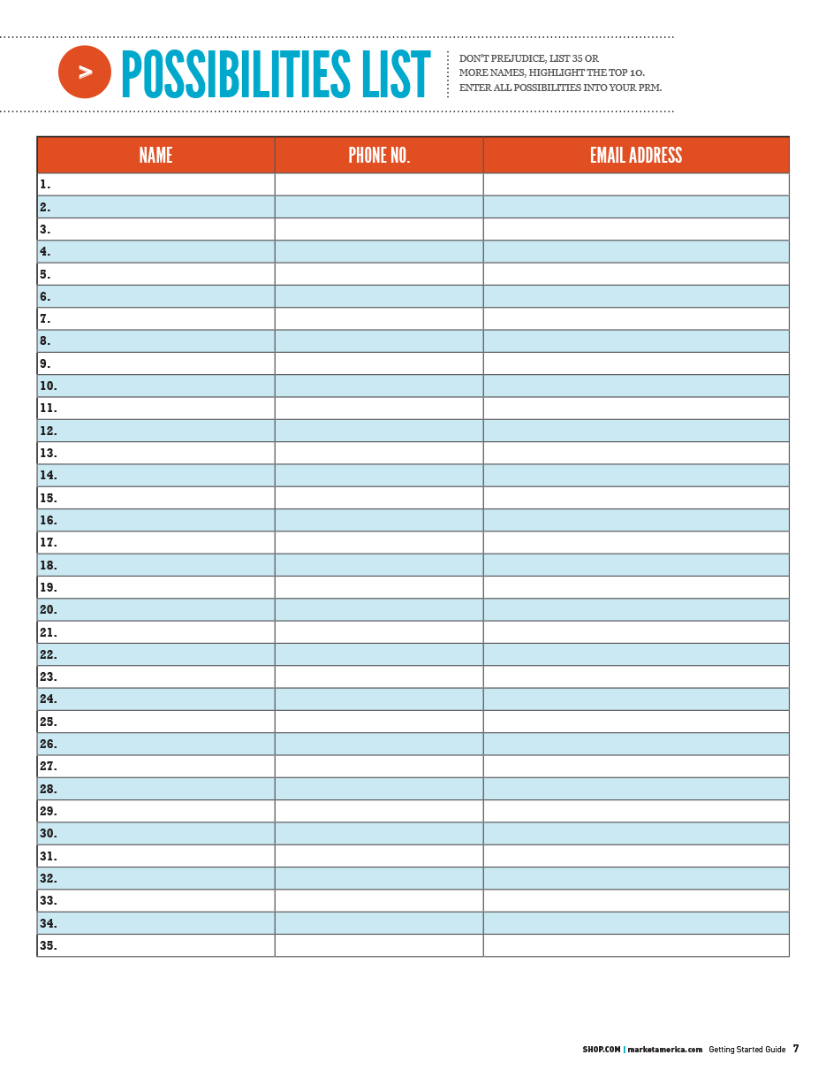
Develop a Possibilities List of 60-200 names

Slide 15
Qualifying Your List
Sales or service experience
Teachers, trainers or coaches
Entrepreneurs or business experience
Attitude, people magnets
Money, people who have it, people who had it and lost it or people who are working toward it
Prior networking or direct sales experience

Slide 16
TOP 10 LIST
After building your list, prioritize the list
Approaches are determined for the top 10 with your business partner
Continue to build relationships with everyone on your list

Slide 17
1
What’s Happening
(Chit Chat, Weather, the news, sports)
2
Their Dream
3
Their Complaints
BECOMING A
MASTER
RECRUITER
People talk about three things

Slide 18
BEFORE THE PLAN
Ask questions and learn about them
FORMDH (Family, Occupation, Recreation, Money, Dream, Health)
People will be attracted when you show that you care,
you are excited, and you believe in your business
People buy you

Slide 19
YOUR WHY
This is a testimonial of the real reason WHY you are doing this business accompanied by an appealing description of the business.
I was sick and tired of living month to month on a salary that never seemed to grow. I started this business to create a second income to take the stress out of the month.
I started my UnFranchise® business to establish my children’s college fund.

Slide 20
What stops people from bringing up the business?
What is it?

Slide 21
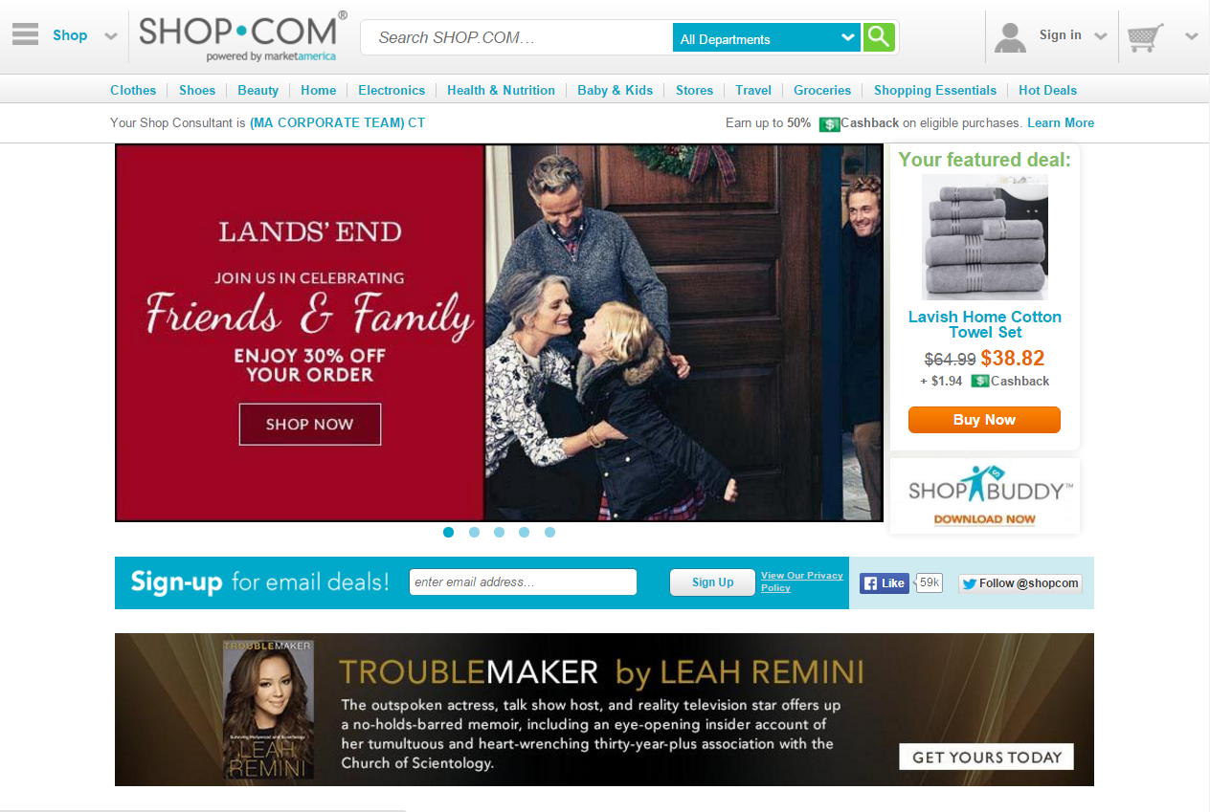
Answer
We are a product brokerage and internet marketing company called SHOP.COM. Have you heard of us?
The answer should be short and intriguing
The goal is to start or continue the dialogue

Slide 22
Have their interest?
When they are asking too many questions, it is time to set the appointment.
“Everything else is hard to explain, let’s discuss it over coffee. Which day works better for you, Monday or Tuesday?”

Slide 23
Scheduling the follow up appointment
It is a successful meeting if a
follow up is
booked
Have your schedule available and book the next step
Schedule a follow up meeting to answer questions or get started
You have to continue to follow up until they get started or let you know they are not interested
Sense of urgency is crucial, book the follow up within 48 to 72 hours if possible

Slide 24
Recruiting is…
Shaking the Bean Jar
Filtering through the Funnel
The follow up, providing information, answering questions, showing the plan, and making the close!

Slide 25
Adding to your names list is just as important as building it
Possibilities Are Everywhere
Add two names per day

Slide 26
Belief is the foundation for prospecting and recruiting. It begins with WHY and belief in the concept from knowledge and experiencing it.
The only real learning is experiential
Get clear about the business.
BECOMING A
MASTER
What is the alternative?
RECRUITER
Get proud of the business.

Slide 27
RECRUITING
REFLECTS BELIEF !

Slide 28
Prospecting, Recruiting and Sponsoring

Slide 29
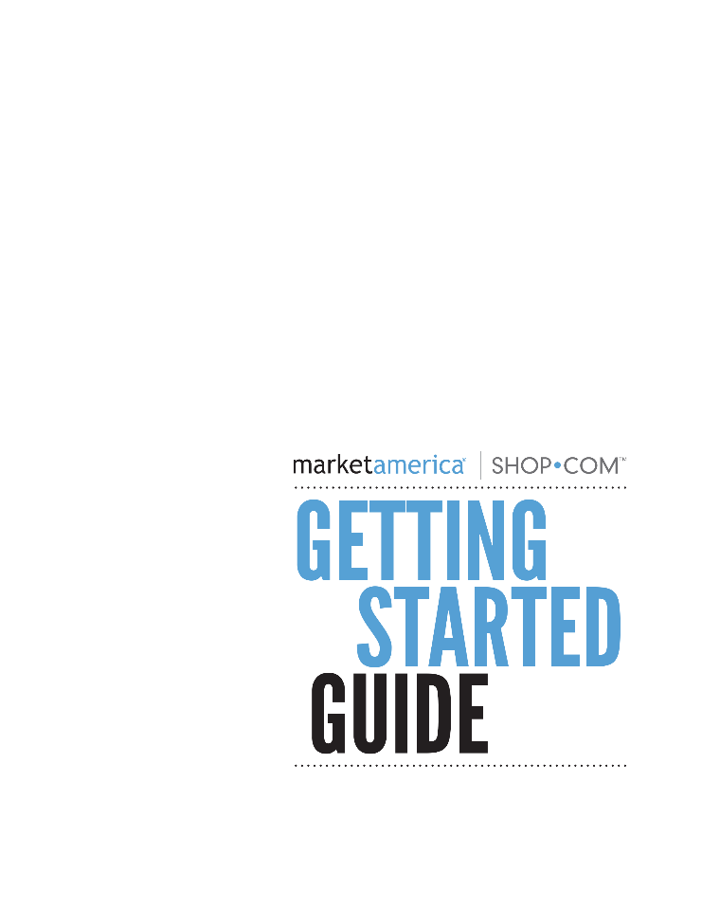
The Getting Started Guide is your roadmap for your first year as an UnFranchise® Owner

Slide 30
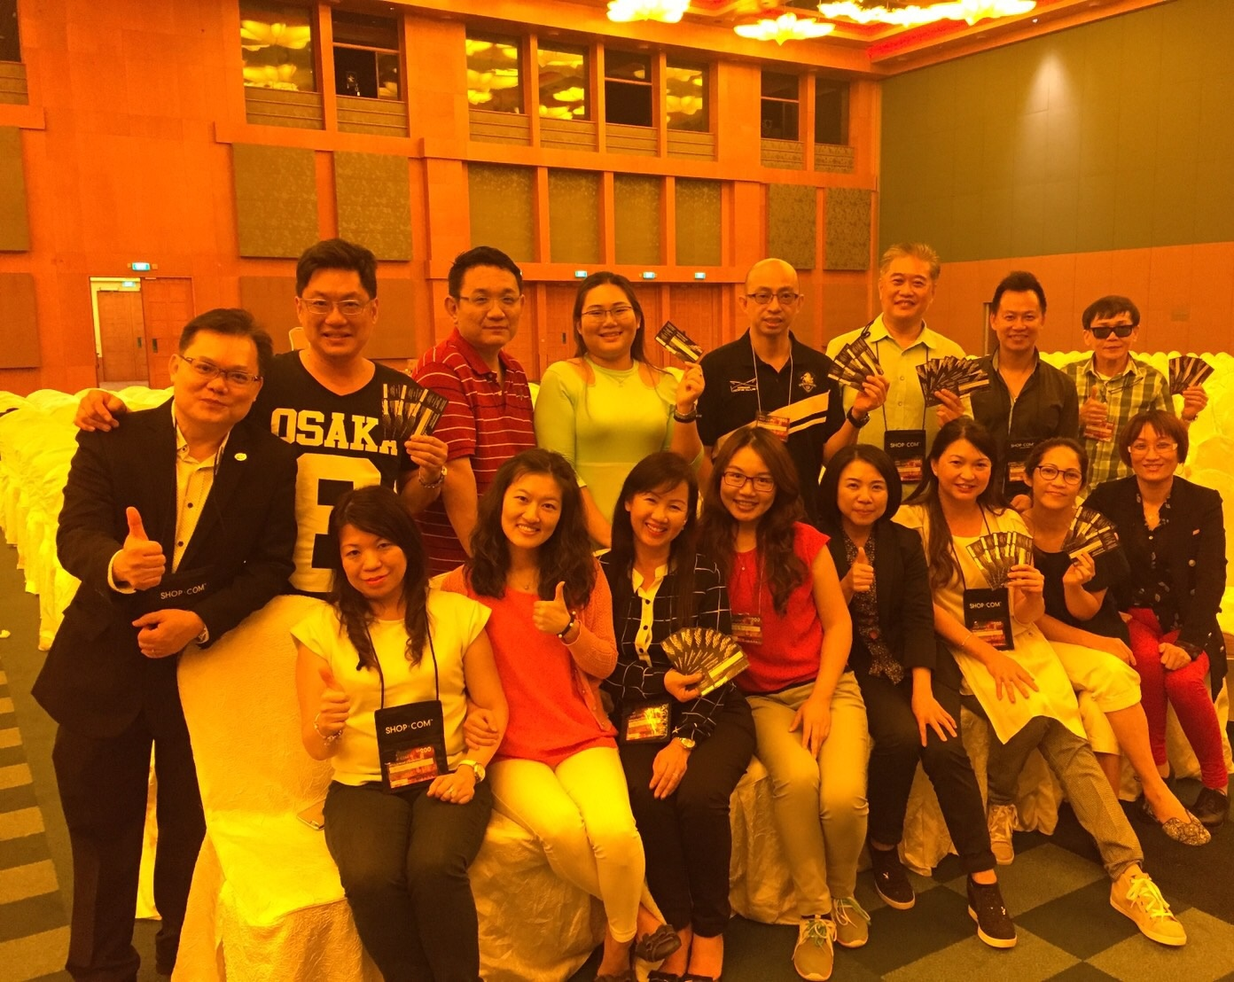
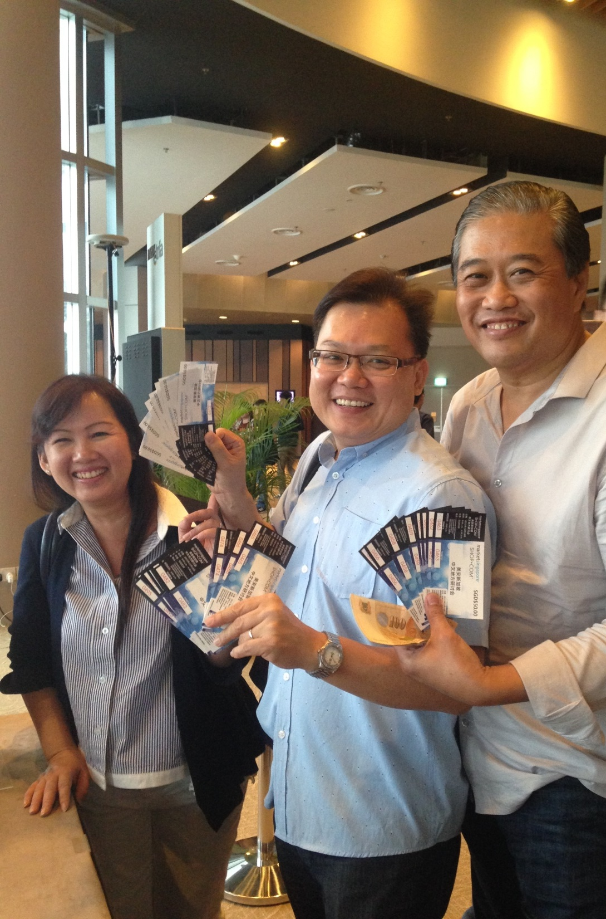
FOLLOW THE SYSTEM
Is the best way to leverage.

